Slide 1
Monthly Rainfall Prediction in India
Aashish Kumar

Slide 2
Outline
General
Stationary Model
Stationary Model Forecast
Non-Stationary Model
Non-Stationary Model Forecast
ARMAV
Conclusion

Slide 3
Rainfall In India
Monsoon season in India
Starts from May and ends around August
India is heavily dependent on monsoon for irrigation, recharging ground water, water in rivers, dams
Its prediction is critical for farmers who rely heavily on rains for irrigation
Its prediction also helps government plan ahead how to manage water resources

Slide 4
Rainfall Data
Monthly rainfall data(in mm) collected from Jan 1901 to Dec 2015.
Data from Jan 1901 to Dec 2010 is used to build the model
Model accuracy is tested on data from Jan 2011 to Dec 2015
Data available on : https://data.gov.in/catalog/rainfall-india

Slide 5
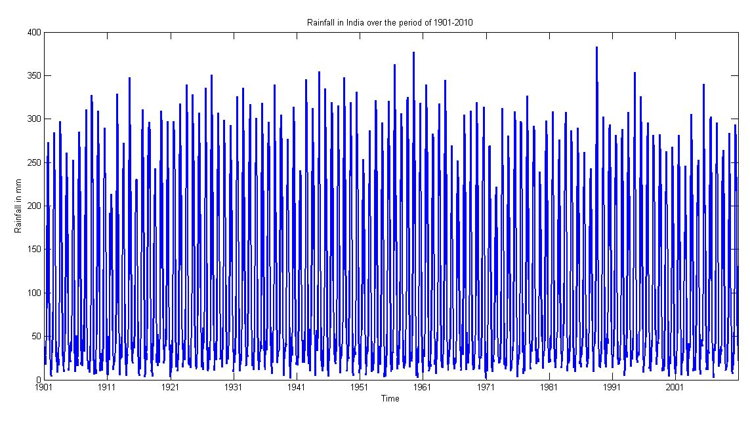
Rainfall Data

Slide 6
Stationary Model
ARMA (2n,2n-1) Technique, F-test is used
ARMA(10,9) is found to be adequate model
RSS = 8.6831e+05

Slide 7
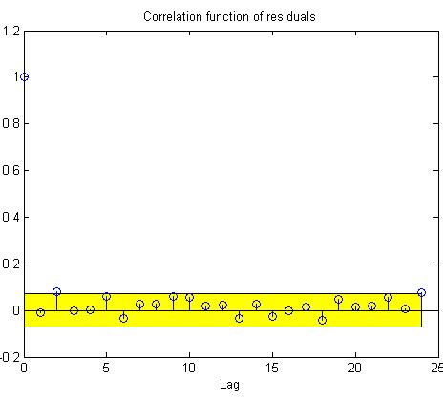
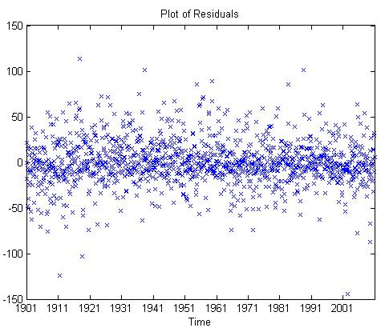
Residual correlation

Slide 8
AutoRegressive Roots
Roots | Absolute Value | Angle | Period of Seasonality
-0.9780 + 0.0000i | 0.9780 | 3.1416 | 2.0000
-0.4998 + 0.8658i | 0.9998 | 2.0944 | 3.0001
-0.4998 - 0.8658i | 0.9998 | -2.0944 | -3.0001
0.0000 + 1.0000i | 1.0000 | 1.5708 | 4.0001
0.0000 - 1.0000i | 1.0000 | -1.5708 | -4.0001
0.5000 + 0.8660i | 1.0000 | 1.0472 | 5.9999
0.5000 - 0.8660i | 1.0000 | -1.0472 | -5.9999
0.8660 + 0.5000i | 1.0000 | 0.5237 | 11.9985
0.8660 - 0.5000i | 1.0000 | -0.5237 | -11.9985
0.1357 + 0.0000i | 0.1357 | 0 | -

Slide 9
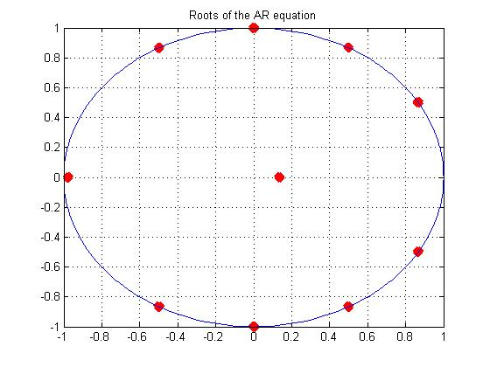
Plot of the Roots

Slide 10
Check for seasonality of 12
Use the operator 1 – 1.7321B + B² on X_{t}
Fit ARMA(8,9) Model
RSS = 8.1430e+05
Model found to be adequate
Seasonality of 12 is confirmed

Slide 11
Check for Seasonality of 6
Use the operator 1 – B + B²
Fit ARMA(8,9) model
RSS = 8.1391e+05
Model found to be adequate
Seasonality of 6 is confirmed

Slide 12
Combined model of seasonality 6 and 12
Use the operator 1 – 2.73*B + 3.732*B² – 2.732*B³ + B⁴
Fit ARMA(6,9) model
RSS = 8.8546e+05
Combined model is inadequate, fails the F-tst
Parsimonious model with seasonality 12 is used as seasonality of 12 coincides with the rainfall pattern in India

Slide 13
Forecast
Forecast for next five years using parsimonious model of seasonality 12
Time period forecasted : Jan 2011 to Dec 2015
95% prediction interval is obtained using Green’s function
Prediction Error : 3.7309e+04
Fails to predict properly when the rainfall is less in the year

Slide 14
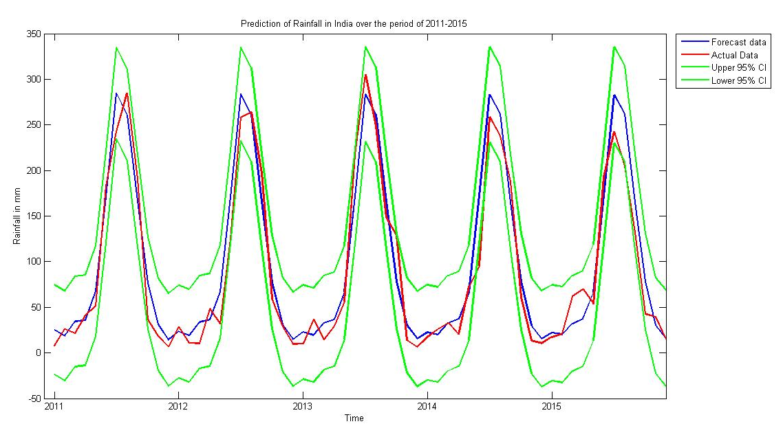
Forecast

Slide 15
Non-Stationary Model
Fitting deterministic trend
Strong seasonality is observed
Fit the periodic trend
All periods period 12, 6, 4, 3, 2 were fit using the least squares approach
X_{t} was fit using ARMA model

Slide 16
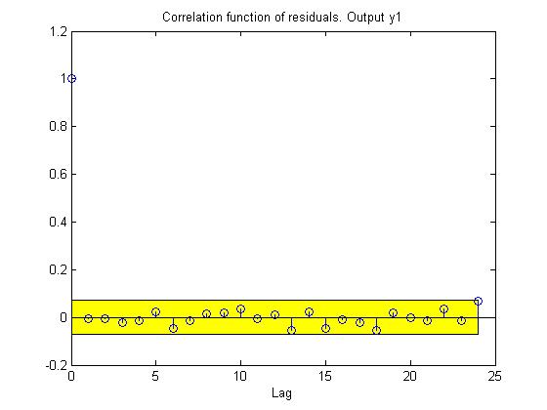
Non-Stationary Model
ARMA(3,2) is the adequate model for X_{t}
Residuals are uncorrelated
RSS = 7.8978e+05

Slide 17
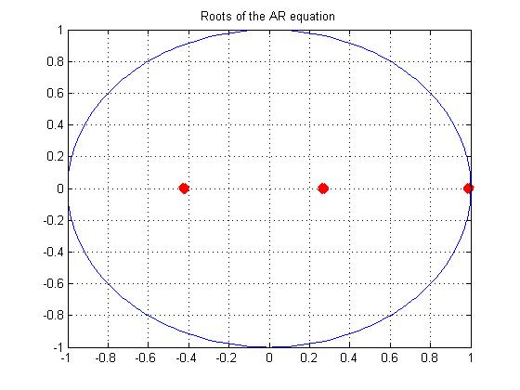
AutoRegressive Roots
All roots are real and inside unit circle
Roots are 0.98,0.26,-0.422

Slide 18
Forecast
Forecast for next five years
Time period forecasted : Jan 2011 to Dec 2015
95% prediction interval is obtained using Green’s function
Prediction Error : 3.9413e+04
Does not perform better than stationary model, prediction accuracy dropped by 5.6%

Slide 19

Forecast

Slide 20
ARMAV Model
Temperature Data : Monthly temperature in Celsius from Jan 1901 to Dec 2015
Temperature data and Rainfall data together are used to build ARMAV model
ARMAV(4,4,3) model is obtained when Rainfall is the output and Temperature is input
ARMAV(7,7,6) model is obtained when Temperature is the output and Rainfall is input
Total RSS = 1.3275e+06

Slide 21
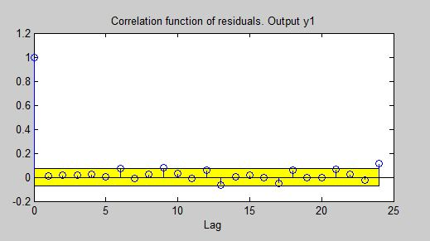
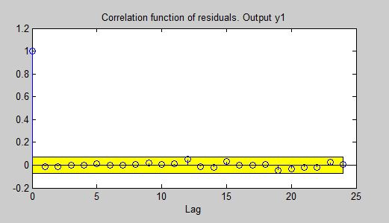
Auto-Correlation of Residuals
Correlation Residuals a1
Correlation Residuals a2

Slide 22
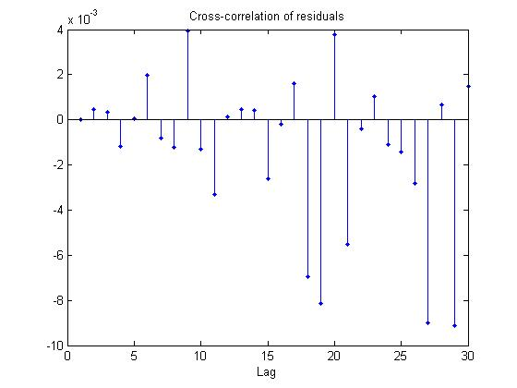
Cross-Correlation Between Residuals

Slide 23
Forecast
Forecast for next five years
Time period forecasted : Jan 2011 to Dec 2015
Prediction error = 1.6687e+05
Prediction error is higher than stationary model but it seems to more closely follow the actual data for first 4 years, prediction is not good for the 5th year

Slide 24
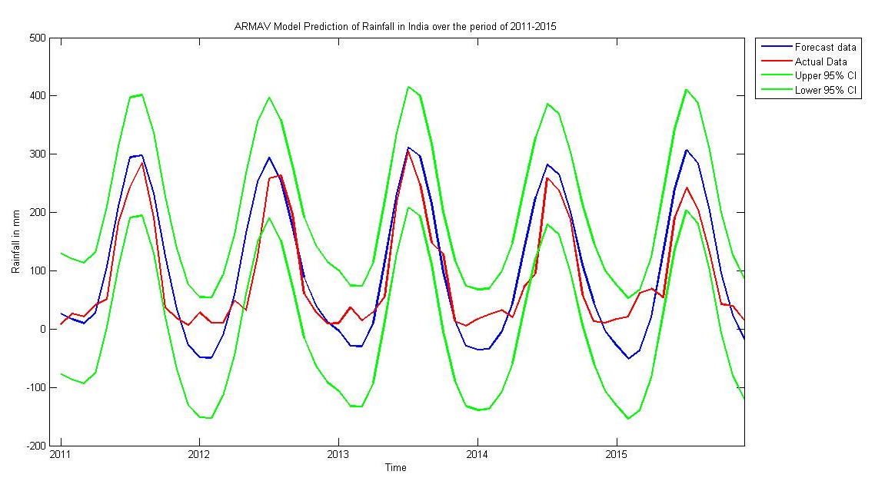
Forecast

Slide 25
Conclusion
Stationary model gives better prediction as compared to non-stationary model and armav model.
Rainfall has seasonality of 12
Rainfall is dependent on lot of factors like wind patterns, weather conditions, global climate, etc. Prediction accuracy can be improved by accounting for these factors

